Slide 1


LECTURE 4: TOEIC WRITING QUESTIONS 1-5
WRITING A SENTENCE BASED ON A PICTURE
WRITING YOUR RESPONSE
PAGE: 101-110

Slide 2



TABLE OF CONTENTS
A
OBJECTIVES
B
CONTENT
C
PRACTICE
D
CONSOLIDATION
E
HOMEWORK

Slide 3





OBJECTIVES
A

Slide 4









Use the correct word order.
Write a sentence with one/two clause (s).
Write sentences that are relevant to photos.
A. OBJECTIVES

Slide 5



CONTENT
B

Slide 6


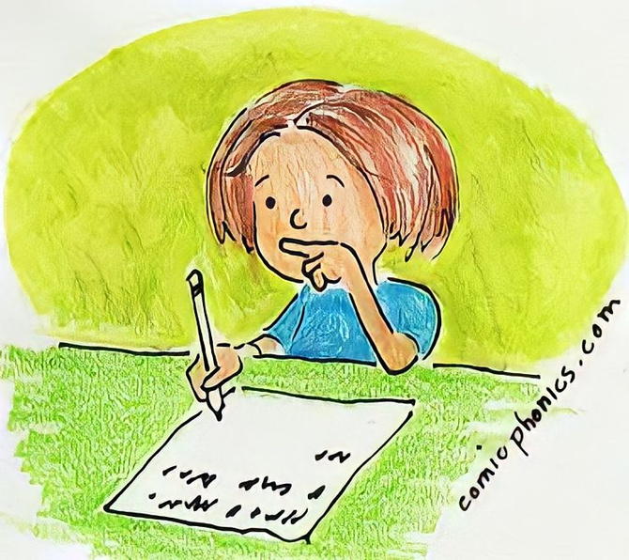

Writing in Questions 1-5:
Remember:
You must be able to write sentences that are grammatical, coherent and relevant to the photo.

Slide 7


Tip 1: Understand combinations of word pairs
Noun + noun Verb + noun
Noun + preposition
Verb + preposition
Noun + function word
Verb + function word

Slide 8
Tip 1: Understand combinations of word pairs
Noun + subordinating conjunction
Adverb + subordinating conjunction
Verb + subordinating conjunction
Preposition + subordinating conjunction
Adjective + subordinating conjunction

Slide 9
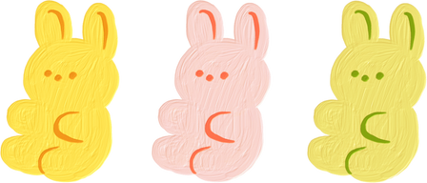

Parts of Speech in the Word Pairs
Parts of Speech
Explanations
Uses in Sentences
Examples
Refer to a person, place, or thing.
Can be the subject of the sentence.
The woman is holding the bag.
Nouns
Refer to an action, state, or feeling.
Should go after the subject
He drinks from the big mug.
Verbs
Usually come before nouns or pronouns .
Can be part of the subject or objects clause.
The old man is walking up the stairs.
Adjectives
Modify nouns/pronouns.
He always wears a long coat.
Adverbs
Modify verbs, adjectives, and other adverbs.
Often come after adverbs
Often end with -ly.
The woman types quickly.
Show the time, space, or logic relationship between things.
Can be part of the subject or object clause.
The computer on the table does not function.
Prepositions

Slide 10



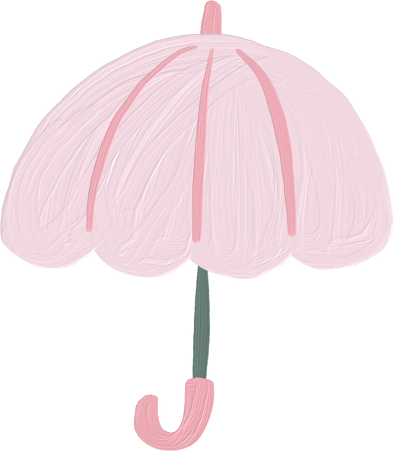


TASK
Write the part of speech for each of the words in the pairs.
1. umbrella/hold__________ ____________
2. helmet/on____________ _____________
3. hair/scissors____________ _____________
4. take/camera____________ _____________
5. refrigerator/empty___________ ___________

Slide 11






Tip 2: Identify the connection between the words & the photo.
Scan the photo quickly for its connection to the words provided.

Slide 12




Task 1:
Write what the subject, verb, and object for each pair might be.
Word Pairs
Possible Subjects
Possible Verbs
Possible Objects
1. woman/suit
2. whiteboard/
behind
3. hold/
documents

Slide 13
Task 2:
Complete each sentence using the
correct form of the word in parentheses.
1. The server ______________(set) the plate on the table.
2. The______________(chair) are stacked on top of each other.
3. He ______________(look) at the menu.

Slide 14
Tip 3: Look for function words.
Content Words
Function Words
Nouns
Verbs
Adjectives
Adverbs
Articles
Auxiliaries
Demonstratives
Quantifies
Prepositions
Pronouns
Conjunctions

Slide 15

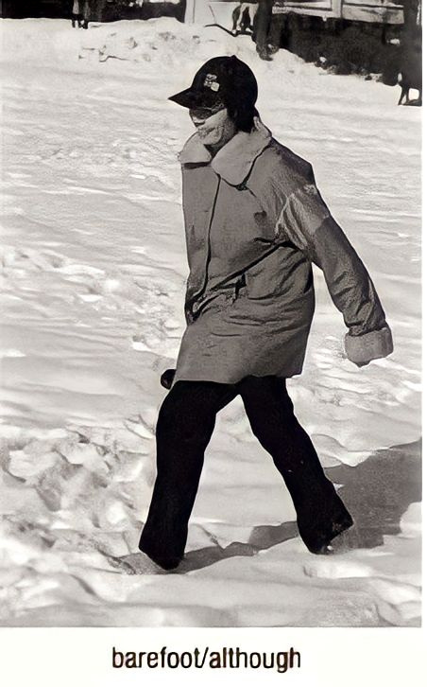
Tip 3: Look for function words.
Consider the function word “although”
E.g. This person is barefoot although there is snow on the ground.
<=> Although there is snow on the ground, this person is barefoot .

Slide 16


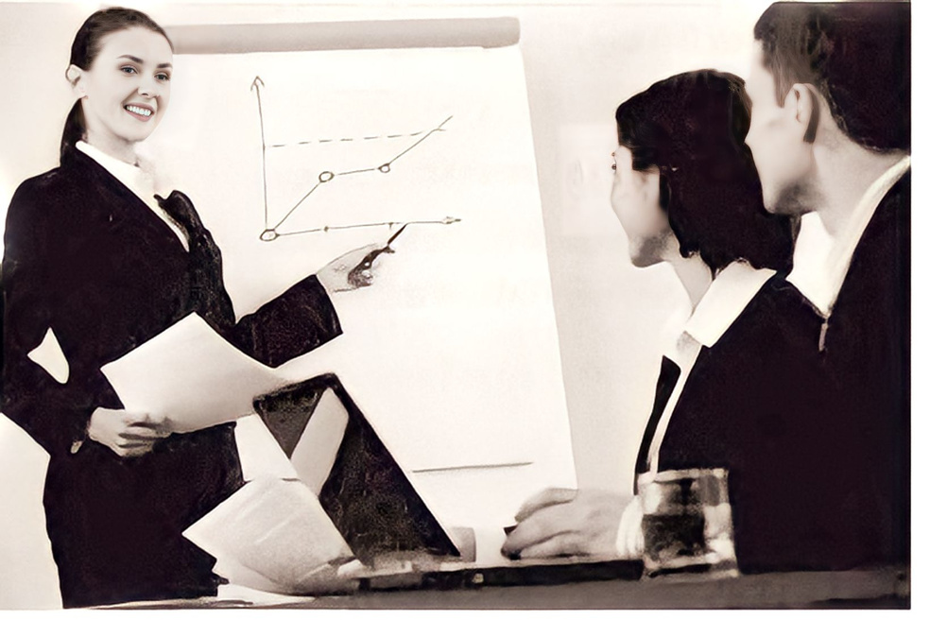
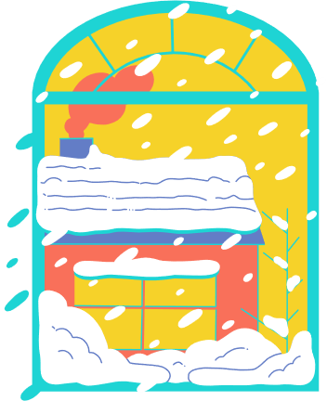
TASK
Look at the photo in Tip 2, decide the meaning of each function word and write a possible .
Word Pairs
Function Word Meaning
Possible First Clause
Possible Second Clause
pen/and
connecting
The woman is holding a pen
and some papers
Whereas the woman is
standing,
her colleagues are sitting
whereas/stand
contrast
stating a condition
As the woman points to the whiteboard,
she faces the audience
point/as

Slide 17



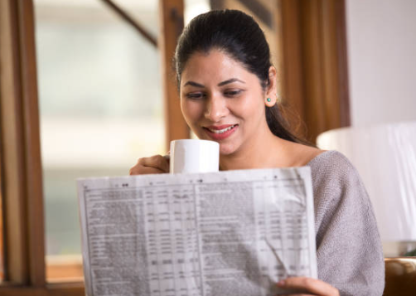
TWO-CLAUSE RESPONSES
Tip: Look for conjunctions
Often in questions 4 &5.
==> While the woman reads the newspaper, she drinks her coffee.
Or: While the woman drinks her coffee, she reads the newspaper.

Slide 18

TASK: Choose the correct conjunction to complete each sentence.
1. You will miss your flight (unless / if ) you hurry.
2. (Because / Even though) it was dark, we turned on the lights.
3. He only has a light jacket, (but / so) he must be cold.
4. The woman is driving, (nor / yet) she is talking on her cell phone.

Slide 19
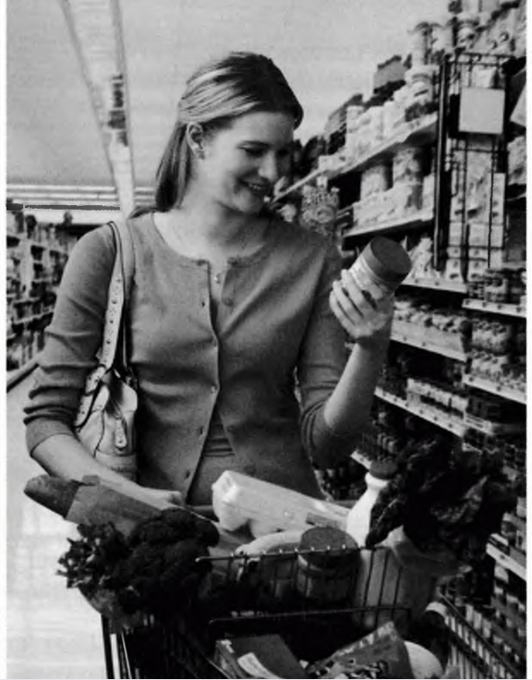
RELEVANCY
Tip: Be sure your response is relevant to the photo.
Task:
1. Which sentence best describes the photo?
a. The woman is pushing the cart through the aisle.
b. The woman thinks the aisle is too narrow for the cart to fit.
2. Why was the incorrect answer in number 1 NOT a good response?
a. The sentence mentions the woman’s thoughts.
b. The sentence mentions an object that isn’t in the photo.

Slide 20




PRACTICE
C
Get ready

Slide 21

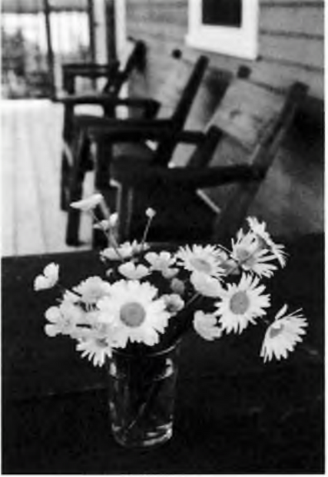
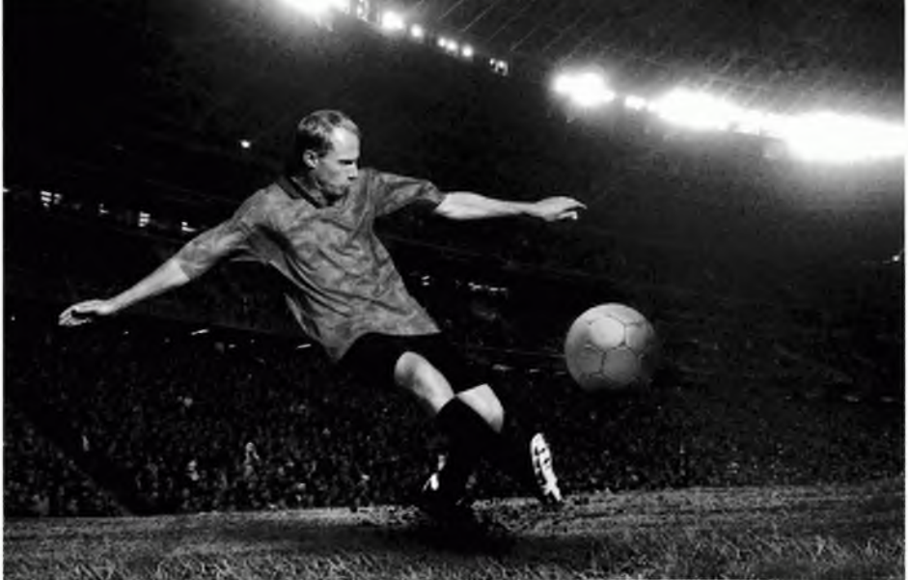



A. Circle the part of speech for each word given. Then circle the most appropriate S, O, and V to fit the photo.
Word Pair: flower/table
Word Pair: man/kick
Word 1
noun
verb
preposition
Word 1
noun
verb
preposition
Word 2
noun
verb
preposition
Word 2
noun
verb
preposition
Subj./Obj.
flower
flowers
table
tables
Subj./Obj.:
man
men
ball
balls
Verb:
is
are
Verb:
kick
is kicking

Slide 22



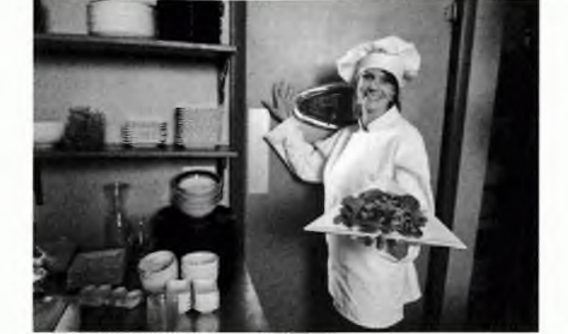




Ci﻿rcle the part of speech for each word given. Then circle the most appropriate S, O, and V to fit the photo.
Word 1
noun
verb
preposition
Word 2
noun
verb
preposition
woman/by
Subj./Obj.:
woman
women
door
doors
Verb:
stand
is standing

Slide 23
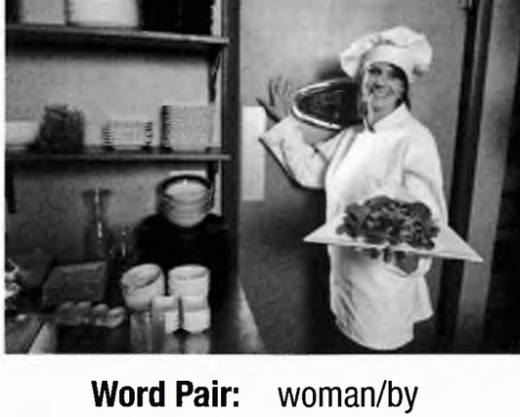
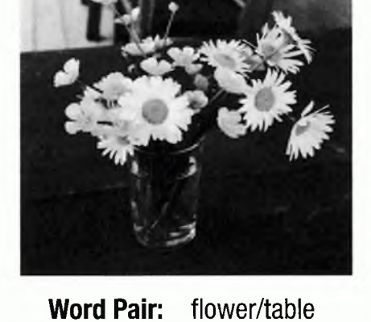
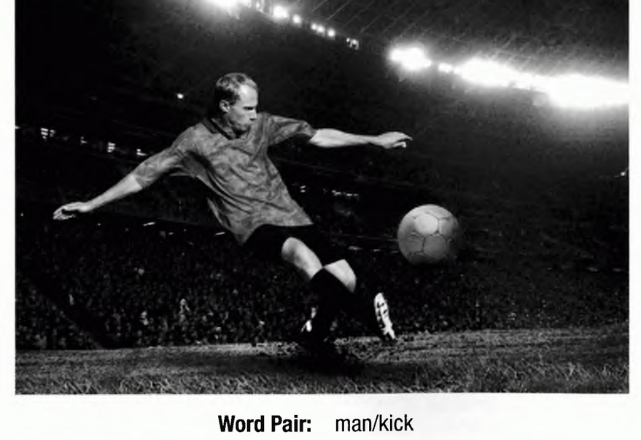
B. Look at the photos and word pairs in Part A. Check the best response for each photo. For each incorrect response, write the letter of the reason it is wrong.
a. grammar error
b. forgotten key word
c. not relevant to photo
1. ___Are flowers on the table.
___ The flowers are on the table.
2. ___The man is in the stadium.
___ The man is kicking the ball.
3. ___ The woman is standing by the door.
___ There is a woman by her house.

Slide 24
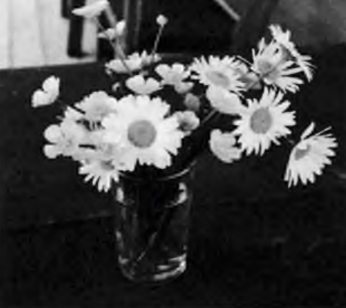
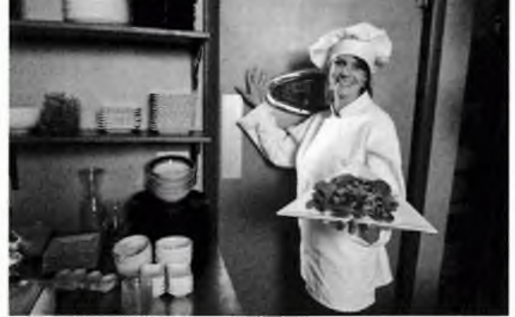
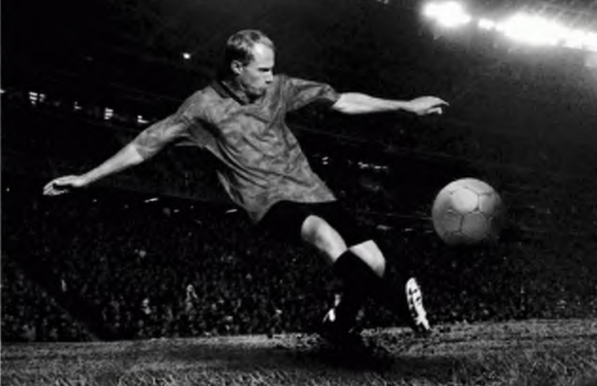

C. Write your own sentences for the photos in Part A. Use the word pairs given.
1. vase/on
_________________
2. play/stadium
___________________________________
3. carry/tray
___________________________________

Slide 25


Response Checklist: Questions 1-5
D. Evaluate your responses in Part C using the checklist below. How well did your responses meet the scoring criteria?
YES
NO
1. My response has a subject and a verb.
2. I used correct verb forms..
3. I used correct noun forms (singular/plural).
4. I used both key words.
5. My response is relevant to the photo.

Slide 26
PRACTICE
C
Get set

Slide 27
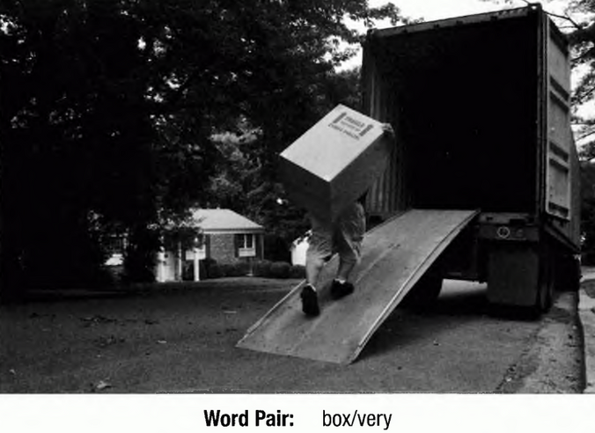
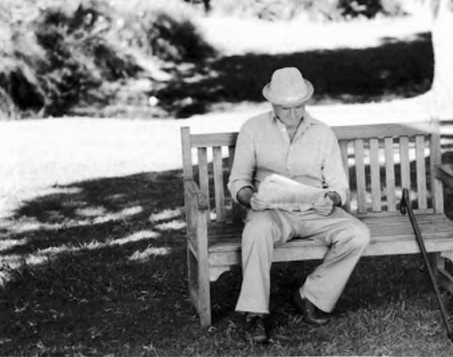

A. Write the correct part of speech for each word in the word pair. Choose a possible S &V.
Word Pair:
box/very
Word Pair: sit/on
noun
verb
Part of Speech: Word 1 ______
Word 2 _____
Subject: _________________
Verb: _________________
Part of Speech: Word 1 ______
Word 2 _____
Subject: _________________
Verb: _________________
adverb
preposition
box
man
is
sit

Slide 28
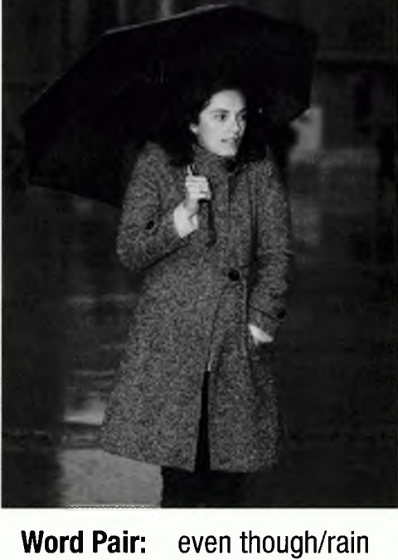

A. Write the correct part of speech for each word in the word pair. Choose a possible S &V.
Part of Speech: Word 1 _________________________
Word 2 __________
Clause 1 Subject: _______Clause 1 Verb:________
Clause 2 Subject: __________ Clause 2 Verb:________
Subordinating conjunction
verb
it
is raining
woman
is standing
Clause 1 and Clause 2 can be reversed; the order doesn’t matter.

Slide 29


B. Write a response for each photo by answering the questions with complete sentences.
1. Is the box very heavy or very light?_____________________
2. Where is the man sitting?___________________________
3. What is the woman doing even though it is raining?
_________________________________________________

Slide 30




C. Now create your own responses for the photos using these new word pairs.
1. carry/back___________________________________________________
2. sit/while______________________________________________________
3. woman/cold__________________________________________________

Slide 31


D.
CONSOLIDATION
What have you learnt today?
- Write a sentence based on picture and given words.
- Practice.

Slide 32

HOMEWORK
E.
- Practice: p.109-110 .
- Prepare for Lecture 6.

Slide 33








Thank you for your attention!

